Slide 1
Security Documentation: Policies
Policies
Standards
Procedures
Guidelines
https://frsecure.com/blog/differentiating-between-policies-standards-procedures-and-guidelines/

Slide 2
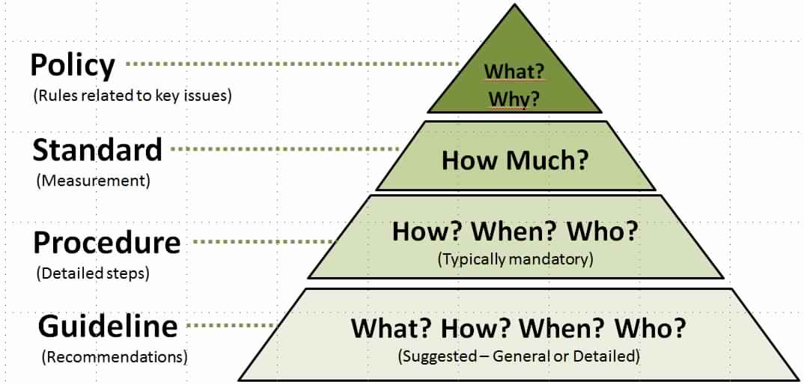
Security Documentation: Policies
https://frsecure.com/blog/differentiating-between-policies-standards-procedures-and-guidelines/

Slide 3
Security Documentation: Policies
Policies
Policies are formal statements produced and supported by senior management. They can be organization-wide, issue-specific or system specific. Your organization’s policies should reflect your objectives for your information security program.

Slide 4
Security Documentation: Policies
Policies
Your policies should be like a building foundation; built to last and resistant to change or erosion.

Slide 5
Security Documentation: Policies
Policies
1. Driven by business objectives and convey the amount of risk senior management is willing to accept.

Slide 6
Security Documentation: Policies
Policies
2. Easily accessible and
understood by the
intended reader

Slide 7
Security Documentation: Policies
Policies
3. Created with the intent to be in place for several years and regularly reviewed with approved changes made as needed.

Slide 8
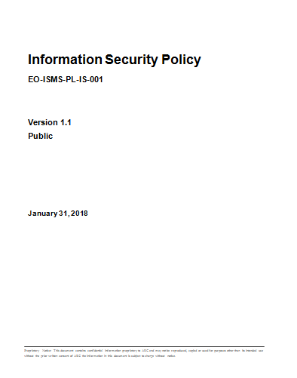
Security Documentation: Policies
TITLE
DOC #
VERSION #
CLASSIFICATION
DATE

Slide 9
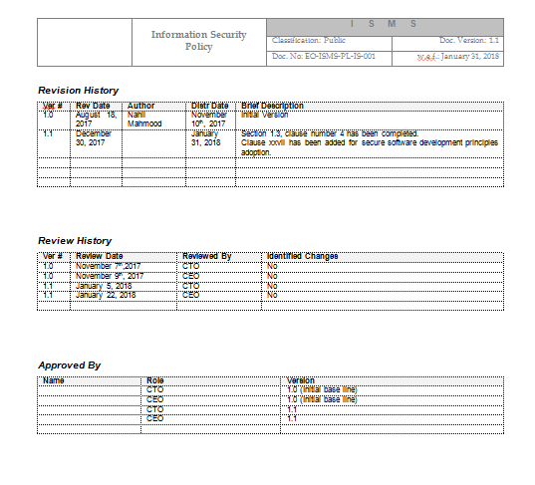
Security Documentation: Policies
HEADER
REVISION HISTORY
REVIEW HISTORY
APPROVED BY

Slide 10
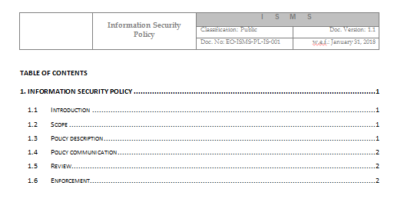
Security Documentation: Policies

Slide 11
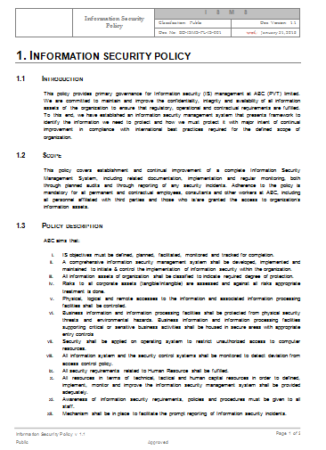
Security Documentation: Policies
INTRODUCTION
SCOPE
POLICY DESCRIPTION

Slide 12
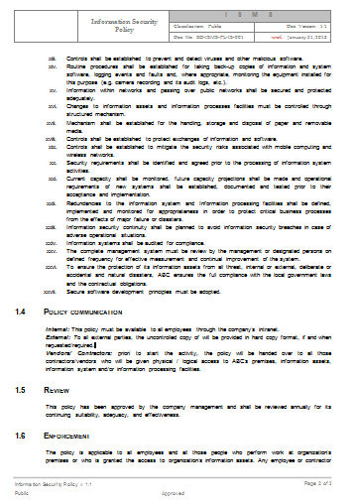
Security Documentation: Policies
POLICY COMMUNICATION
REVIEW
ENFORCEMENT

Slide 13
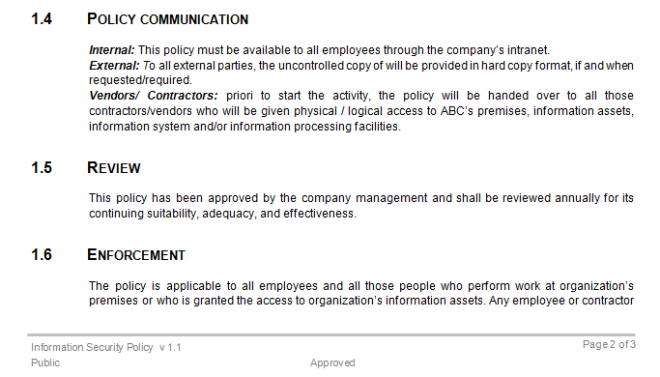
Security Documentation: Policies

Slide 14
Security Documentation: Policies
Policies
Standards
Procedures
Guidelines
https://frsecure.com/blog/differentiating-between-policies-standards-procedures-and-guidelines/
END

